Slide 1

Image Based Visual Servoing (IBVS)
Center of Artificial Intelligence and Robotics (CAIR)
Submitted to : Dr. Amit Shukla
Guided by : Karan Raj Pant
Presented by : Dhruv Gupta

Slide 2
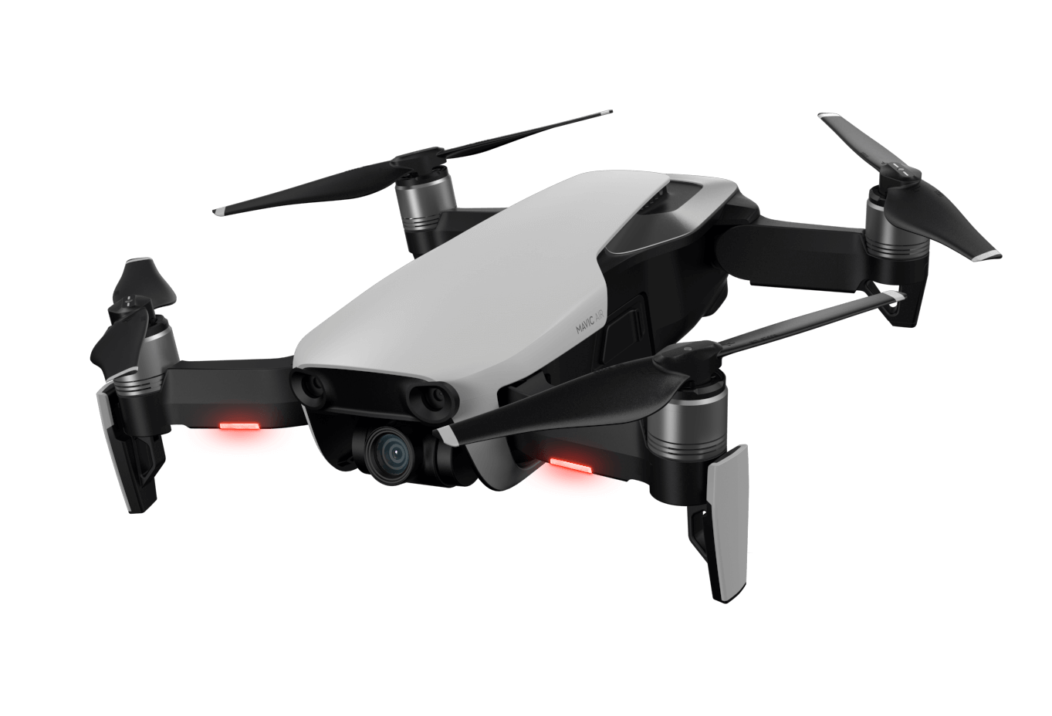
TABLE OF CONTENTS
Timeline
Problem Statement
Robot Kinematics
Aruco Marker
Wifi Module ESP8266
IBVS Simulation

Slide 3
TIMELINE
1st Week - Basics of robot kinematics , Mechanism & Mobility , Kinematic models
2nd Week - Drone Bootcamp
3rd Week - Aruco Marker Generation , Detection , Camera Calibration
4th Week - Learning about Ubuntu 20.04 , Ros Noetic 7.0 , Gazebo
5th Week - IBVS Stimulation on Husky Vehicle , Teleoperation in Gazebo
6th week - Report and Presentation making

Slide 4
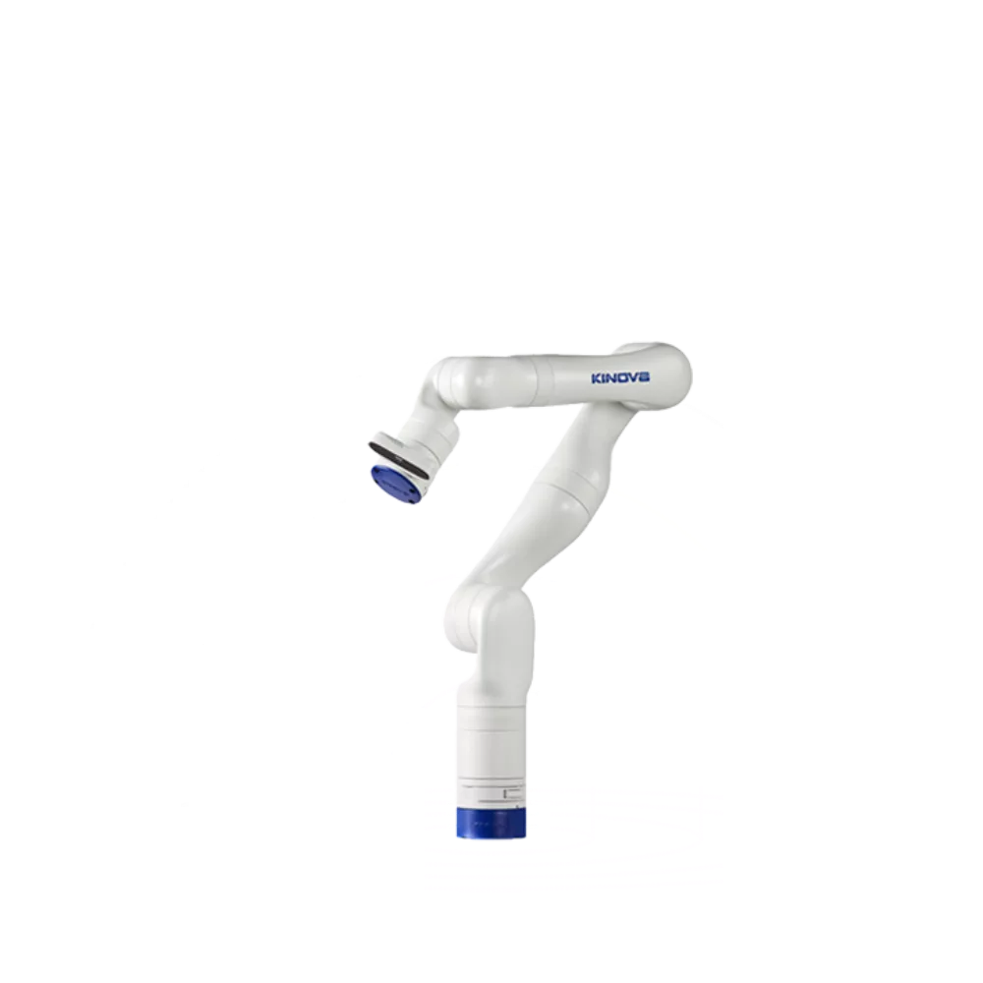
PROBLEM STATEMENT
1. Image-Based Visual Servoing Implementation - Implement an image-based visual servoing (IBVS) system to control the UAV and manipulator based on visual feedback.
Steps to Do It:
Set up a monocular camera and calibrate .
Develop algorithms to extract visual features from the camera feed.
Design the 1BVS controller to adjust UAV and manipulator movements based on visual feedback.
2. Creation of an Animation Video & System Simulations.
Animation: Create an animation video to visually demonstrate the system's operation.
Steps to Do lt:
Use software like Gazebo to create 3D models of the UAV and manipulator.
Steps to Do It:
Use simulation tools like Gazebo.
Integrate the kinematic, dynamic, and visual servoing models into the simulation environment.
Run simulations with various scenarios to test stability, accuracy, and robustness.

Slide 5
ROBOT KINEMATICS
Robot kinematics involves the study of the motion of robotic systems without considering the forces that cause this motion. It primarily focuses on the positions, velocities, and accelerations of the robot's parts.
Types of Kinematics -
1. Forward kinematics -
Forward kinematics is the process of determining the position and orientation of the robot's end-effector given the joint parameters.
2. Inverse Kinematics -
Inverse kinematics is the process of determining the joint parameters that achieve a desired position and orientation of the end-effector.

Slide 6
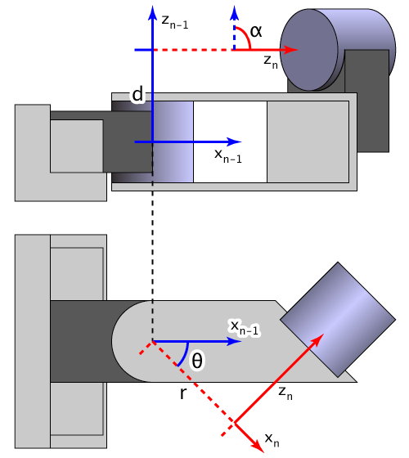
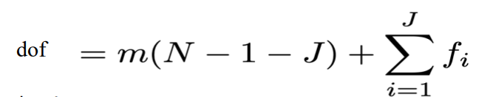
ROBOT KINEMATICS
DH Parameters: The DH convention is a way to define the relative positions of adjacent links. It uses four parameters:
θ (theta): Joint angle for revolute joints.
d: Offset along the previous z-axis to the common normal.
a: Length of the common normal (distance between z-axes).
α (alpha): Twist angle between the z-axes.
Gruebler's Equation -

Slide 7
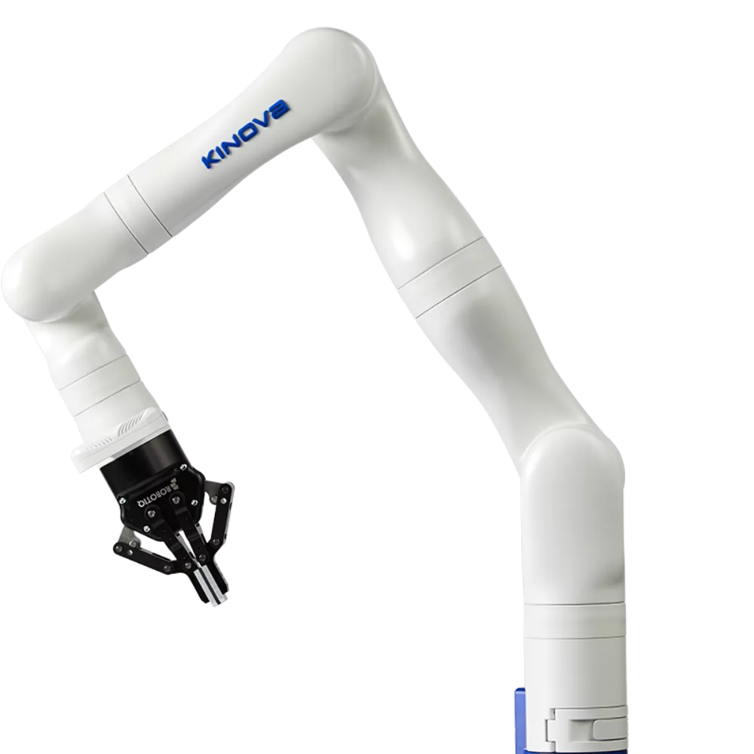
ROBOTIC ARM
Joint -
The connecting parts between segments that allow for movement. These could be revolute (rotational) or prismatic (linear) joints, but they appear to be revolute in our case.
Manipulator - arm -
The main structure of the robot, consisting of several segments and joints.
End - Effector -
The tool or gripper at the end of the arm. This one looks like a robotic gripper used for picking up objects.

Slide 8
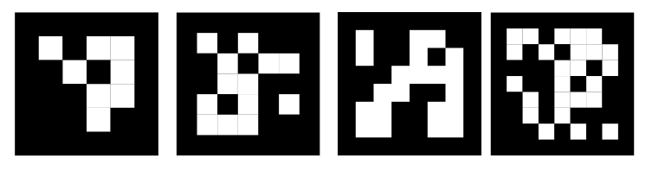
ARUCO MARKER
Aruco markers are a type of fiducial marker used in computer vision applications for camera pose estimation, object tracking, and augmented reality.
Aruco markers are typically square-shaped with a distinctive black border and a unique internal binary pattern.
Different types of aruco marker
4 X 4
5 X 5
6 X 6

Slide 9
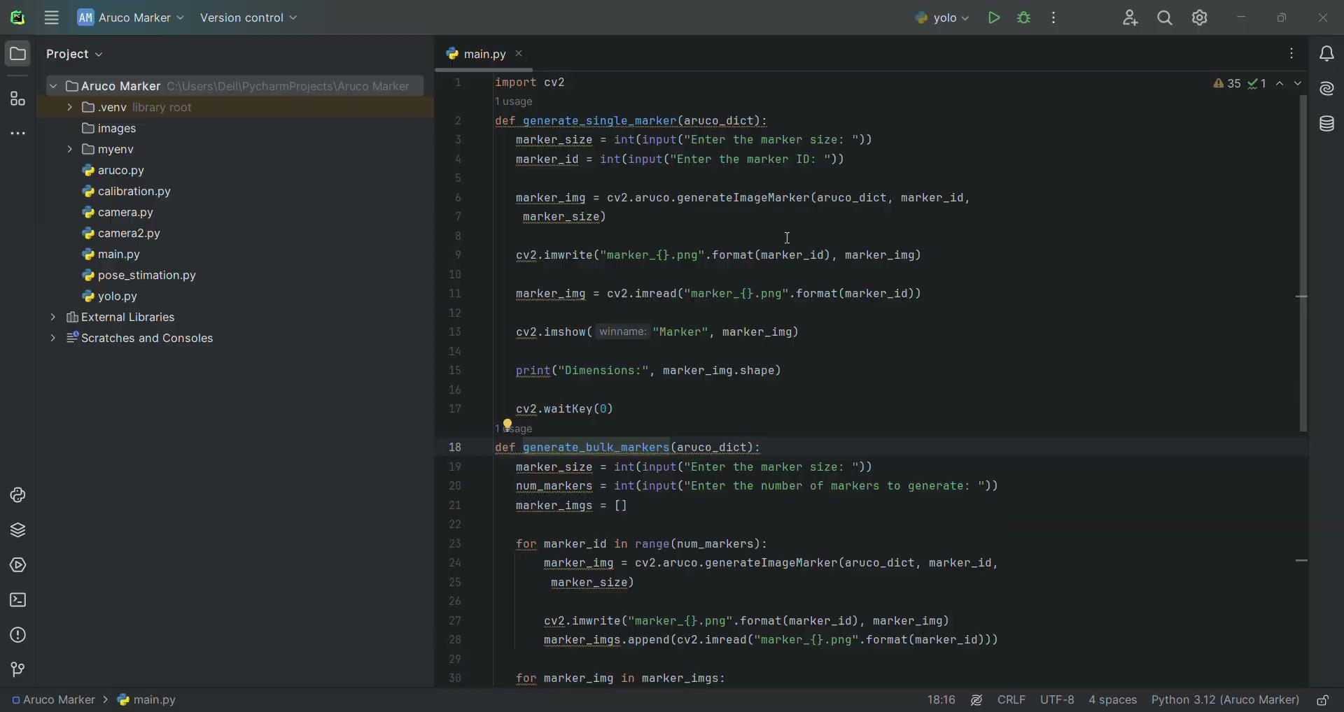
ARUCO MARKER - GENERATION
The process of generating Aruco markers involves creating the binary pattern for each marker and ensuring that it is unique within the chosen dictionary
OpenCV's Aruco module provides a convenient way to generate them.

Slide 10
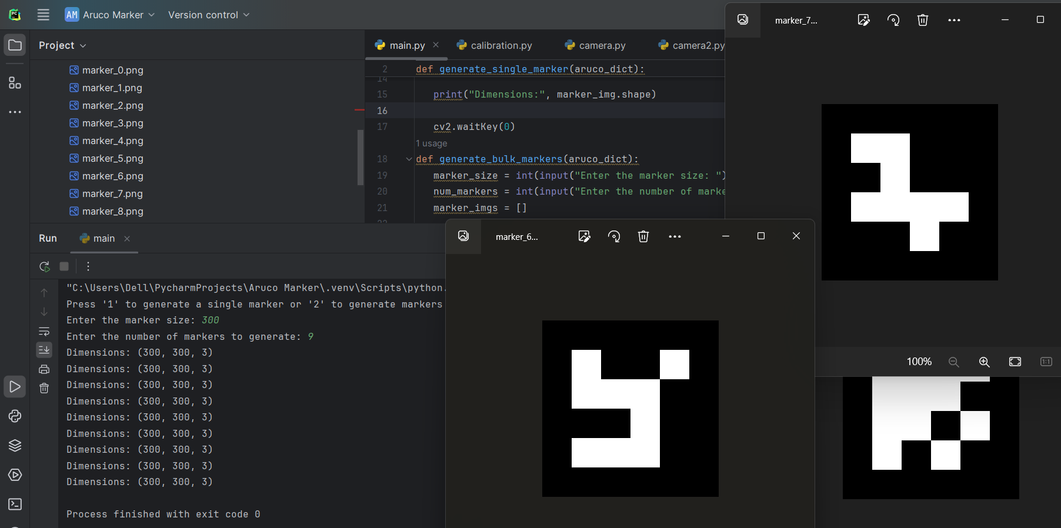
ARUCO MARKER - GENERATION
OUTPUT -

Slide 11

CAMERA CALIBRATION
Camera calibration is the process of estimating the parameters of a camera to improve the accuracy of images taken with it. This involves determining the camera's intrinsic and extrinsic parameters.
It contains 2 types of parameter Intrinsic parameters and Extrinsic parameters.
Intrinsic parameter - Focal length , principal point , skew coefficient , distortion coefficient.
Extrinsic parameter - Rotational matrix, translational vector.
To calibrate the camera , we need 9 * 6 chessboard for it .

Slide 12
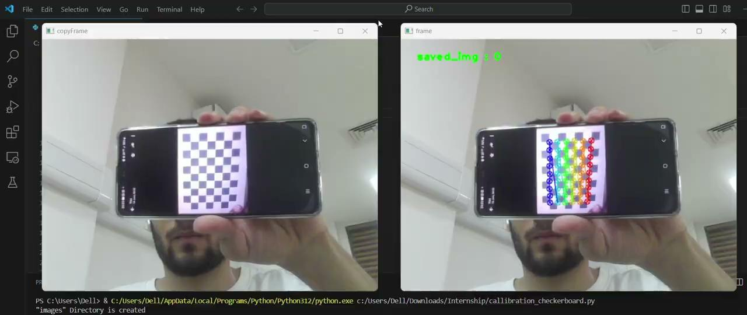
CAMERA CALIBRATION
Video Demonstration

Slide 13
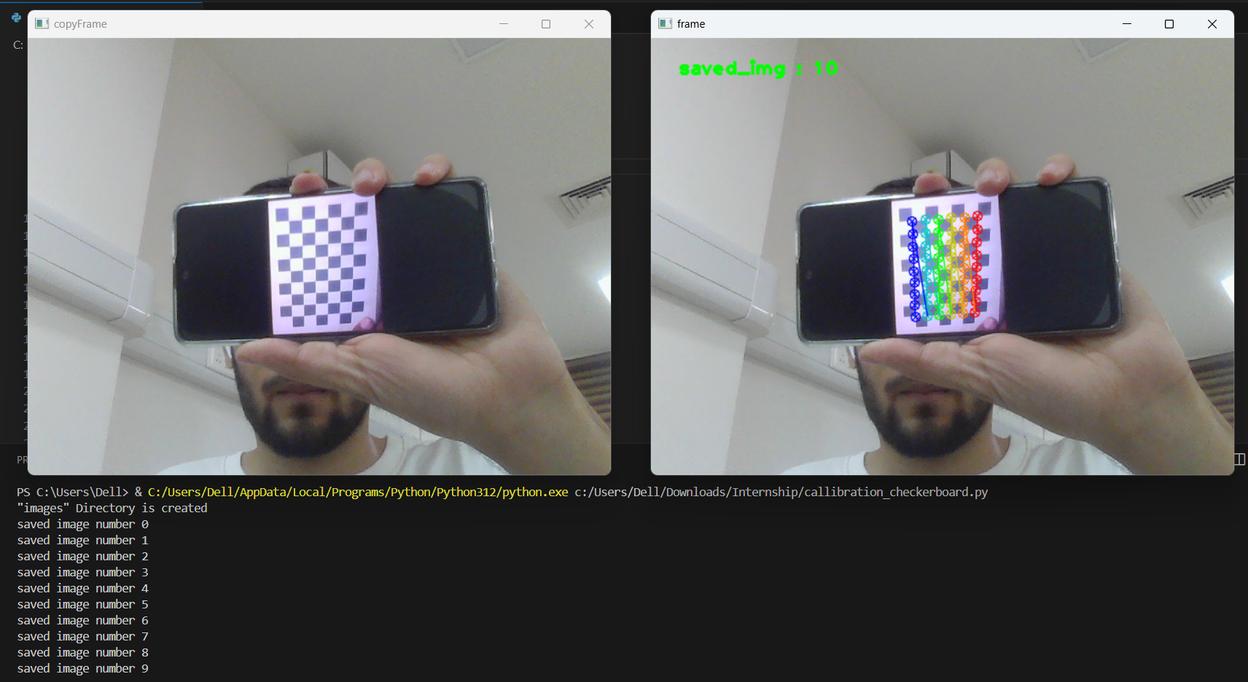
CAMERA CALIBRATION
OUTPUT -

Slide 14
ESP8266 WIFI MODULE
The ESP8266 is a low-cost, high-performance Wi-Fi module capable of providing full internet connectivity to embedded devices. It comes with a built-in TCP/IP stack, making it ideal for IoT applications.
Applications of ESP8266 in IBVS Systems
Real time data transmission
Integration with cloud service
Network Robotic system
Edge Processing

Slide 15
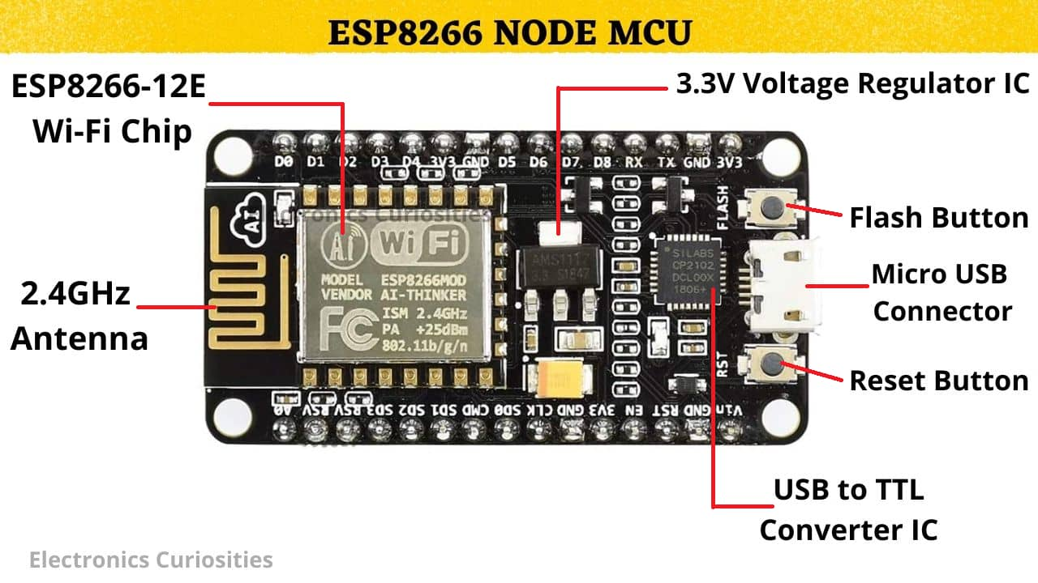
ESP8266 WIFI MODULE
Pin Diagram

Slide 16

IBVS SIMULATION
For IBVS Stimulation we need to install Ubuntu 20.04, ROS Noetic and Gazebo, firstly we need to install the Oracle’s Virtual box 7.0
UBUNTU 20.04
Ubuntu 20.04, codenamed "Focal Fossa," is a long-term support (LTS) release of the Ubuntu operating system. Released in April 2020, it is designed to provide a stable and secure platform for users and developers, with updates and support until April 2025
ROS NOETIC
ROS (Robot Operating System) Noetic Ninjemys is the final LTS release of the ROS 1 distribution.it is targeted for Ubuntu 20.04 and provides a mature, stable platform for robotics development. ROS Noetic is designed to be compatible with Python 3

Slide 17

IBVS SIMULATION
GAZEBO
Gazebo is an open-source robotics simulator that provides an accurate and efficient way to test and develop robotic systems in a virtual environment. It integrates seamlessly with ROS .
Physics Simulation: Offers robust physics engines (such as ODE, Bullet, and DART) for realistic simulation of robot dynamics, collisions, and environmental interactions .
Integration with ROS: Seamlessly integrates with ROS, allowing the use of ROS topics, services, and messages for controlling and monitoring simulated robots

Slide 18
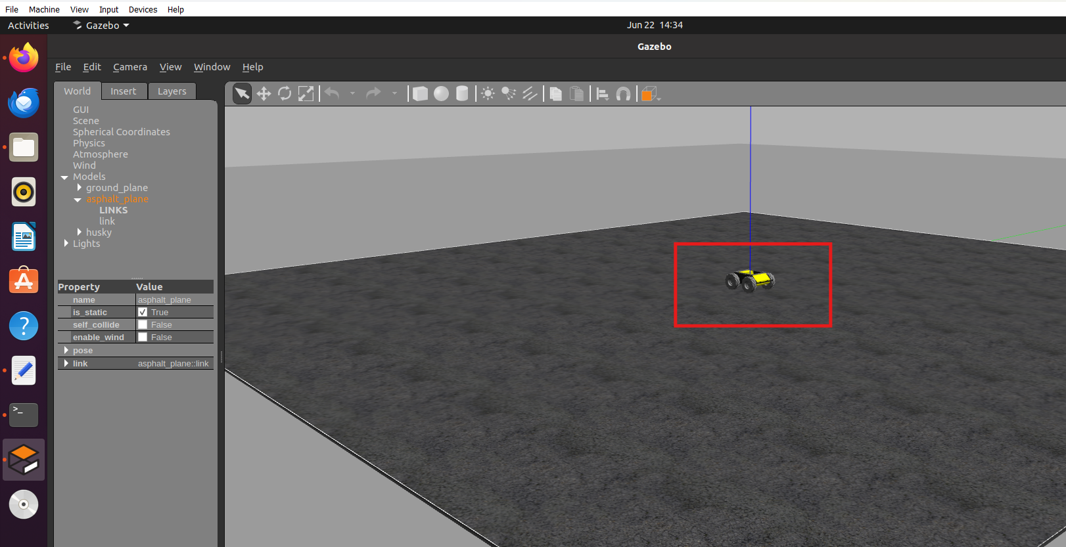
ENVIRONMENT SIMULATION IN GAZEBO
For environment creation we will include husky , asphalt plane and obstacles like Oak tree in the Gazebo.

Slide 19
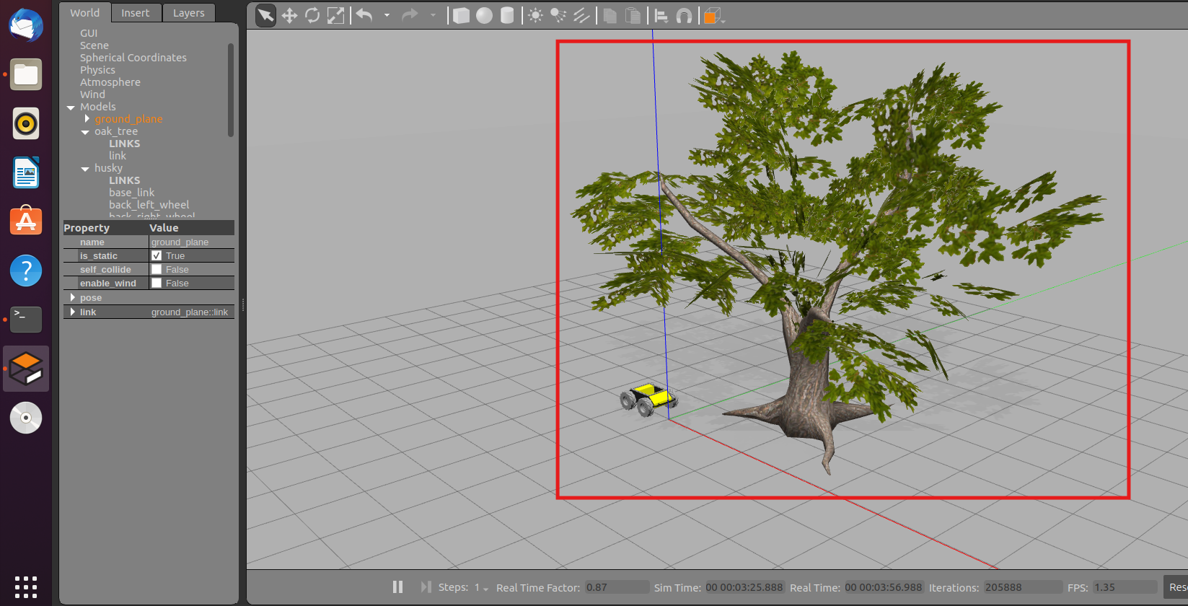
ENVIRONMENT SIMULATION IN GAZEBO
For environment creation we will include husky , asphalt plane and obstacles like Oak tree in the Gazebo.

Slide 20
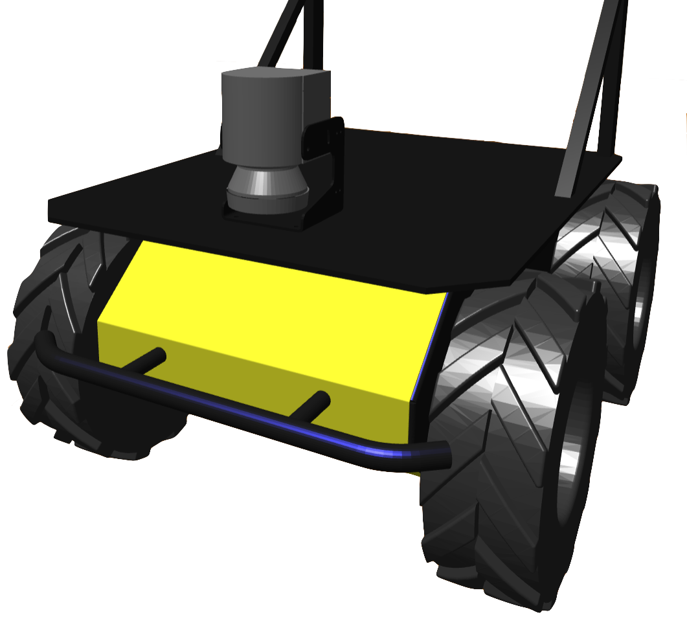
TELEOPERATION ON HUSKY
Teleoperation refers to the remote control of robotic systems, allowing an operator to manipulate the robot from a distance.
The Husky UGV is a versatile all-terrain robot widely used in research and industrial applications.
Ideal for a wide range of applications, including search and rescue missions, industrial inspections, agricultural monitoring, and research in challenging terrains.
Allows operators to control the Husky UGV from a distance, providing flexibility in navigating various terrains and environments without being physically present.

Slide 21
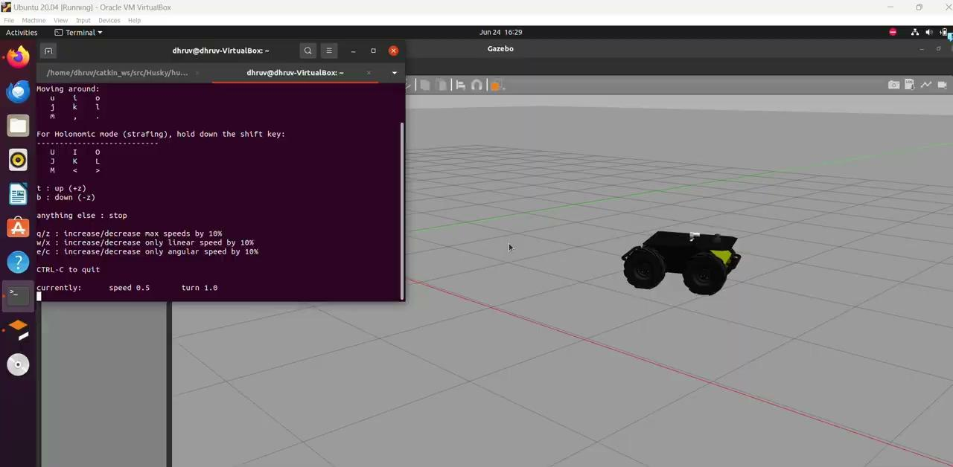
TELEOPERATION ON HUSKY
Video demonstration

Slide 22
THANK YOU

